Slide 1
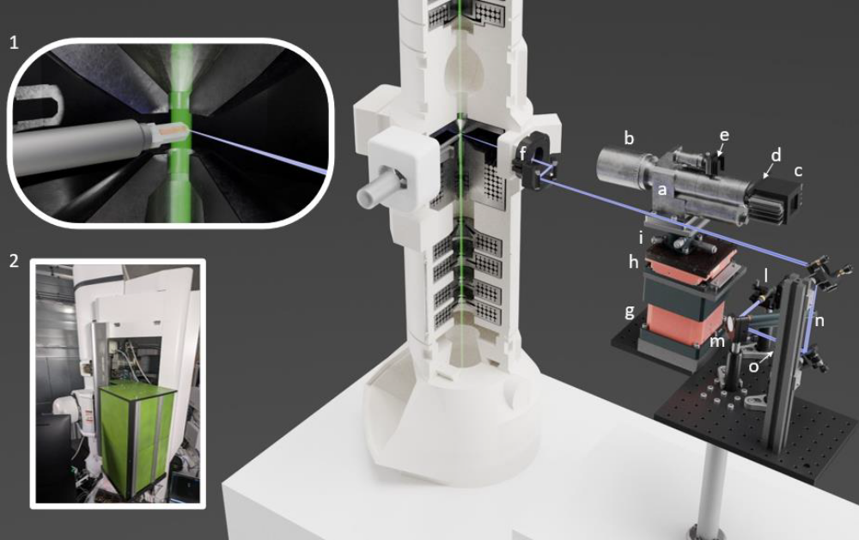

Slide 2
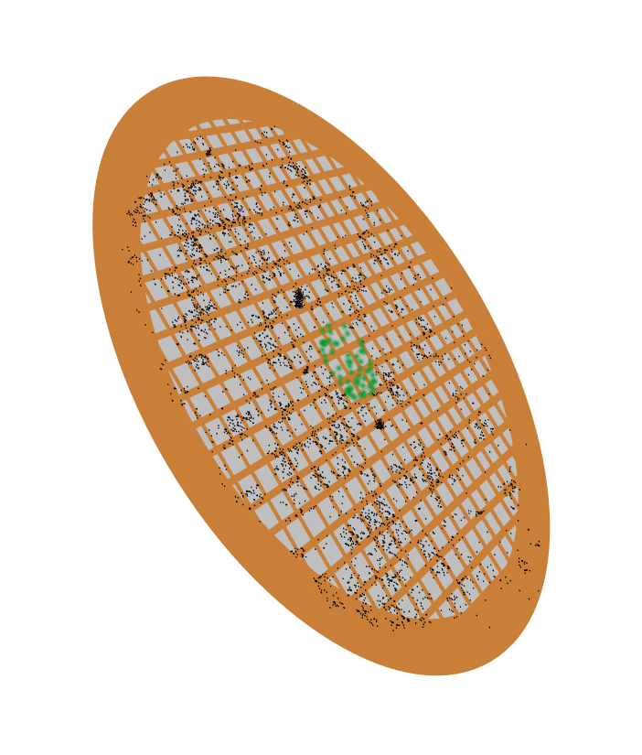

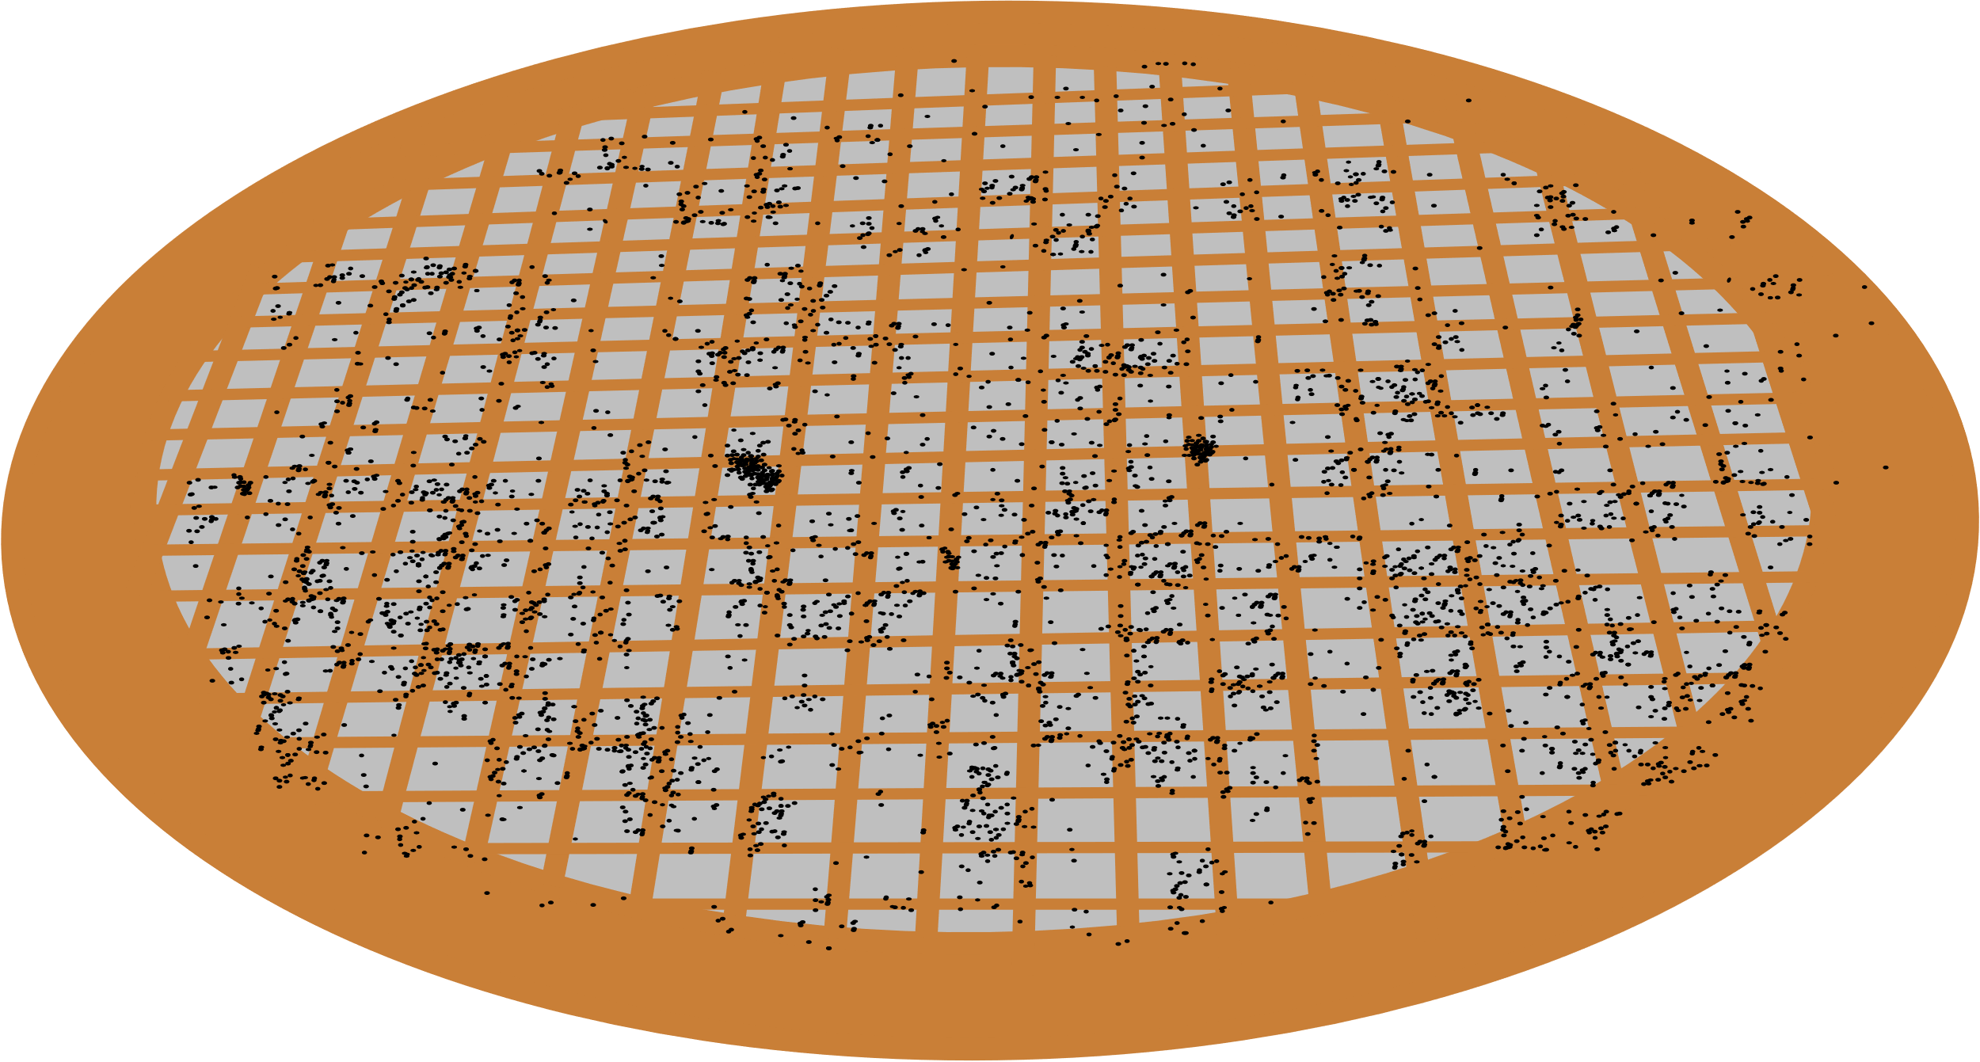
TEM column
Electron beam
200 kV
Fluorescence image
60º
Scanning laser
405 nm
20 cm
Long-distance zoom microscope
TEM
image

Slide 3
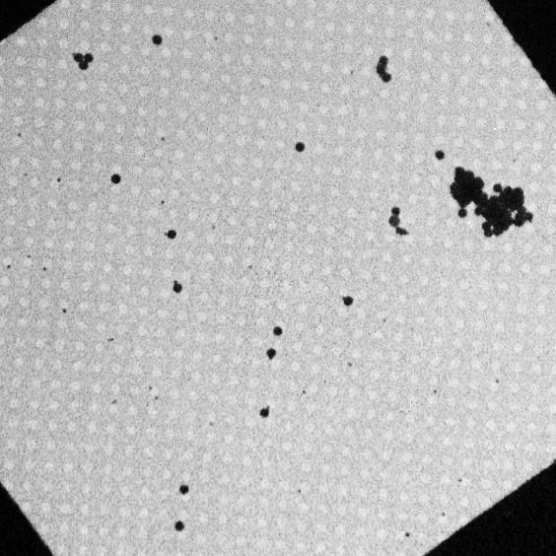
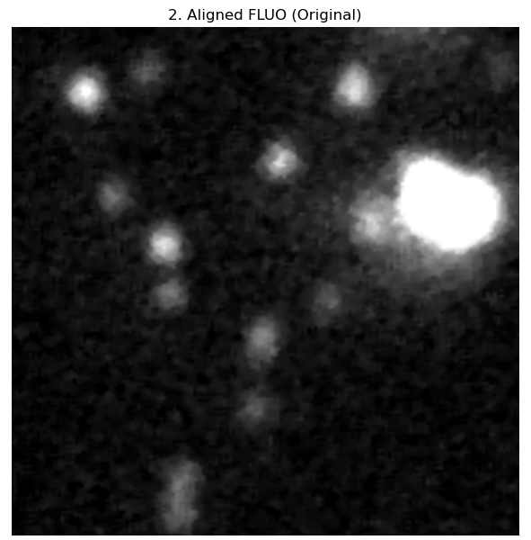
To assess the resolution of the fluo, let’s use these three boxes.
5.5 μm
3.6 μm
2.3 μm
The nominal resolution of our microscope is 4.2, so a single image should resolve only 1
1
3
2

Slide 4
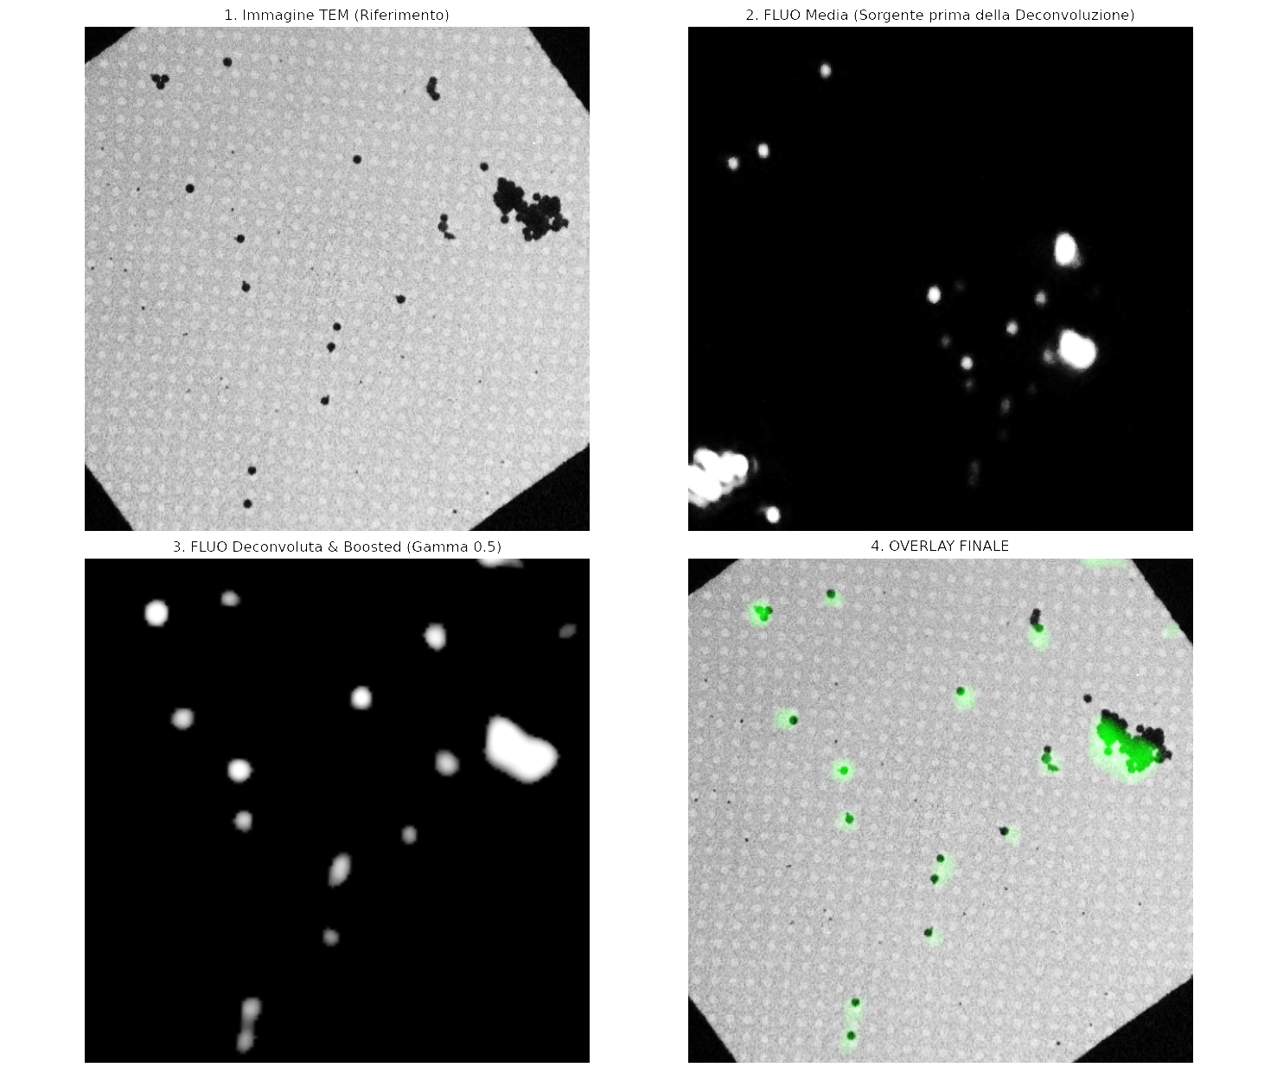
TEM
Single fluo image
Richarson Lucy on single image
Average of 201 images
eSRRF nanopyx
eSRRF nanopyx + 25 RL
≈ 5 μm
Richardson_lucy on the Average

